Slide 1
Hosting Your Page on Github

Slide 2
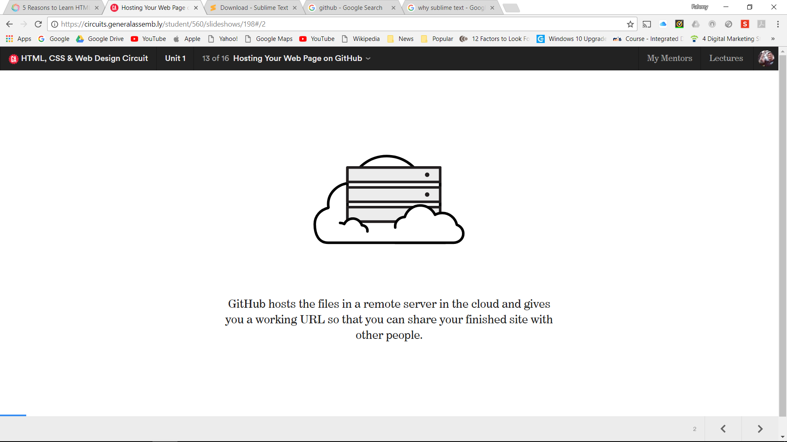
GitHub hosts the files in remote server in cloud and gives you a working URL so that you can share your finished site with other people

Slide 3
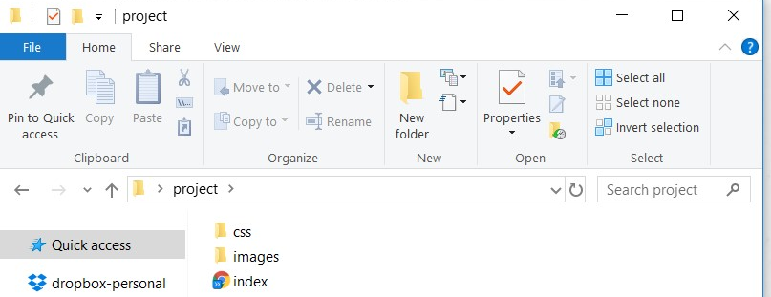
In this guide, we’ll walk you through this process.
First create a folder on your desktop with your project name. In the folder add a folder named css and images. Careful when naming as it is case sensitive.

Slide 4
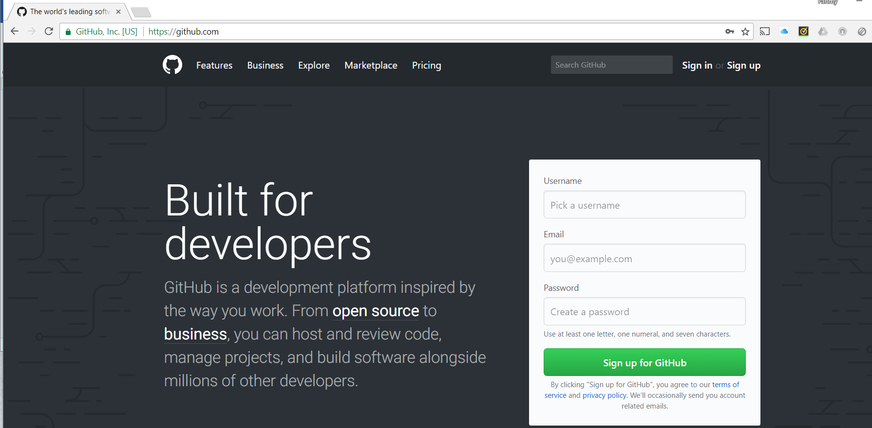
To start, open your web browser and head over to github.com.

Slide 5
The first thing you’ll do is create a username. This step is surprisingly important. Most people use their name, a nickname, or their company’s name. To prevent future issues make your username one word and all lowercase. Proceed to add your email, create a password and signup for GitHub.

Slide 6
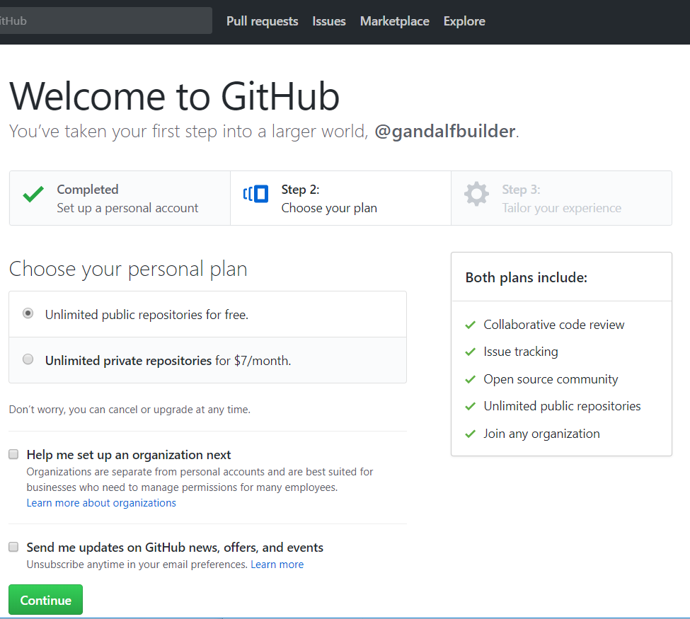

Slide 7
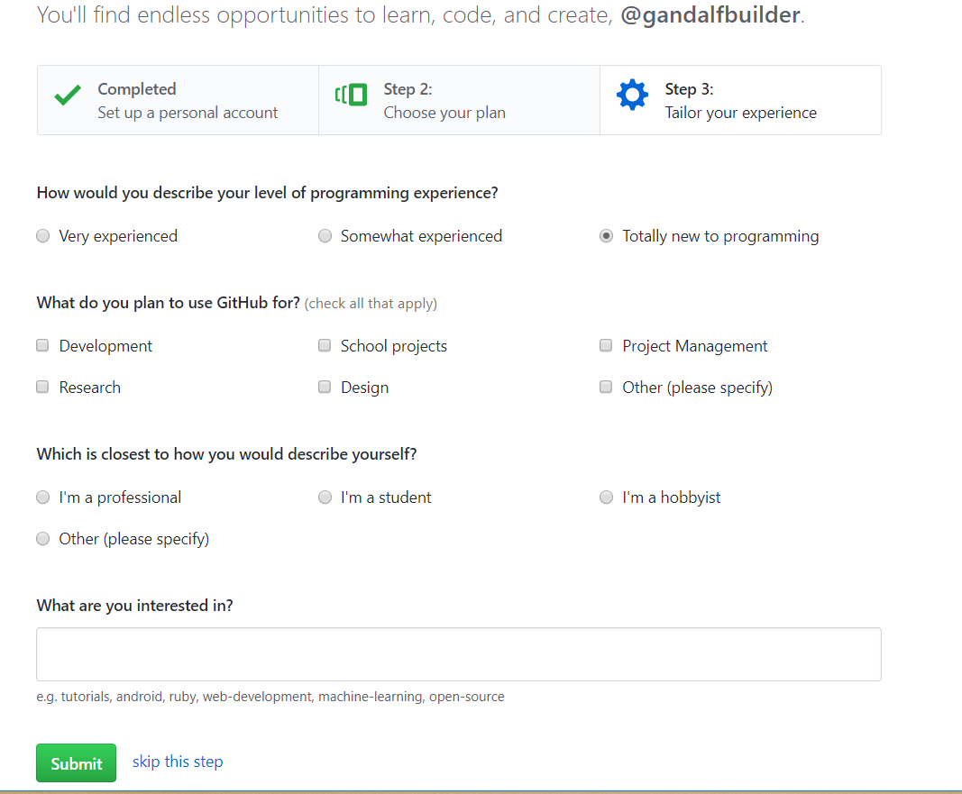
You can choose to fill up the details or just skip this step

Slide 8
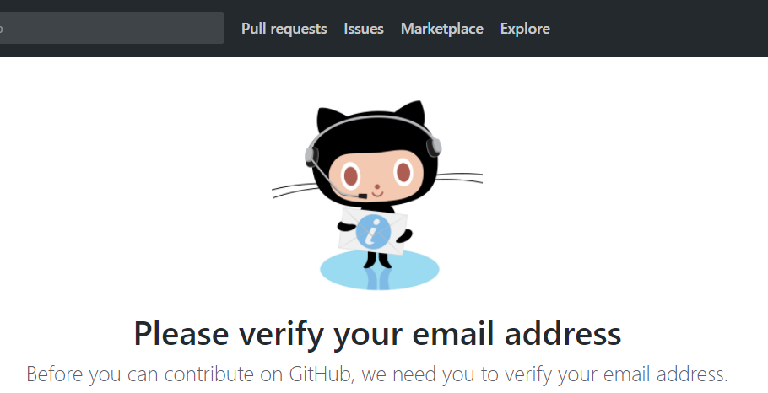
You’ll need to verify your email account. So lookout for an email from GitHub. This step is very important. If you don’t verify your account, your web page won’t work.

Slide 9
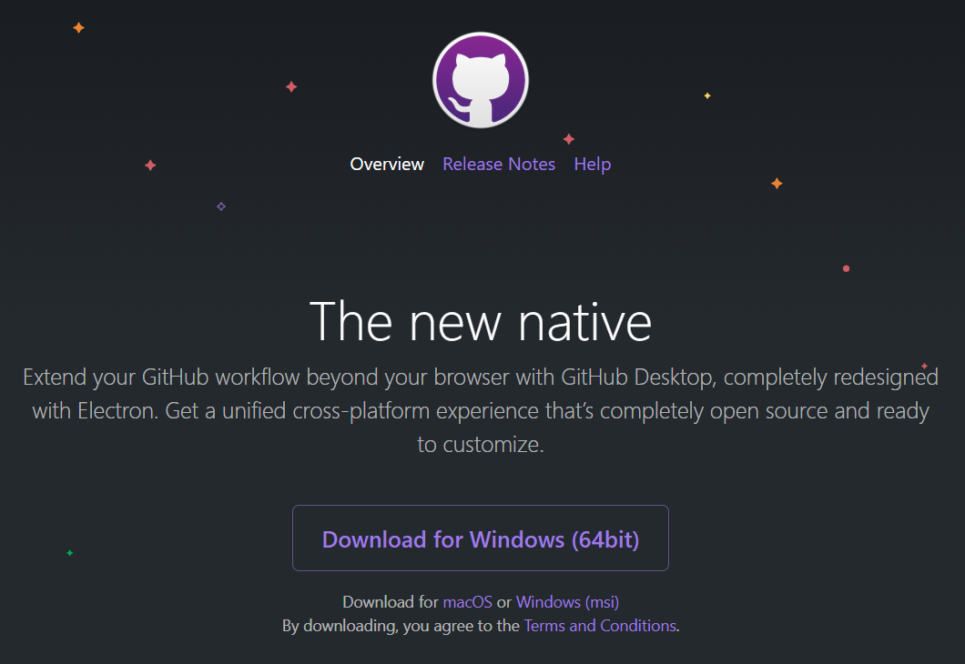
Now that you’ve finished creating a GitHub account you’ll need to download the GitHub app. You can download it for free by visiting desktop.github.com.

Slide 10
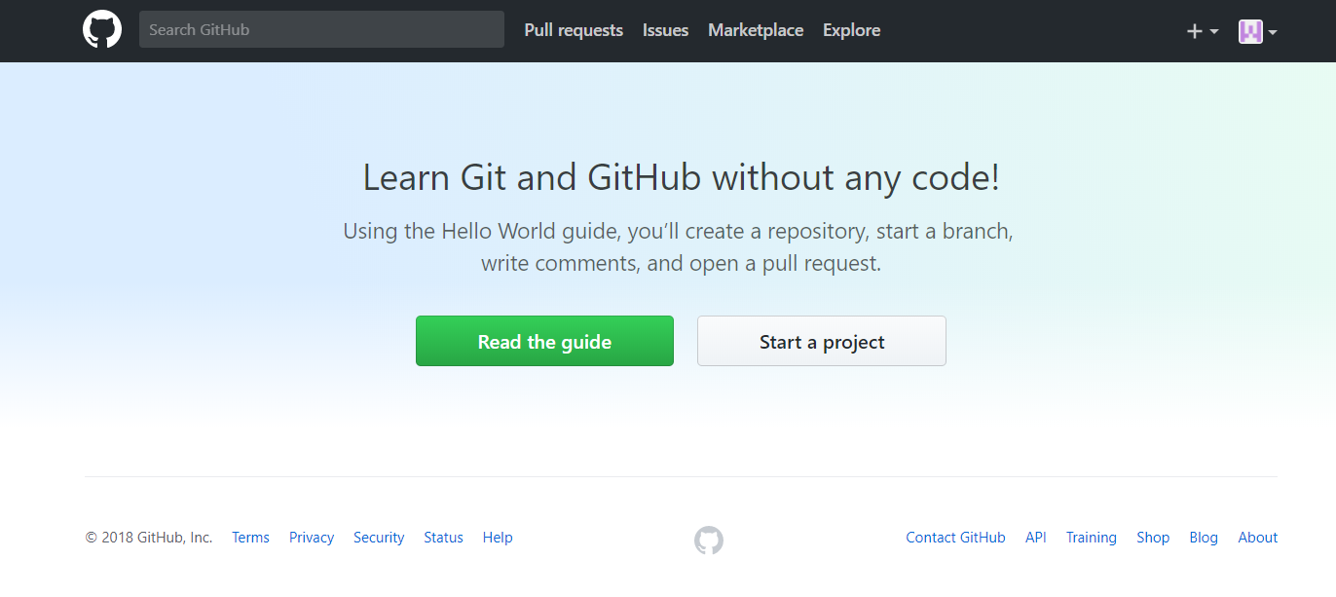
Start a Project

Slide 11
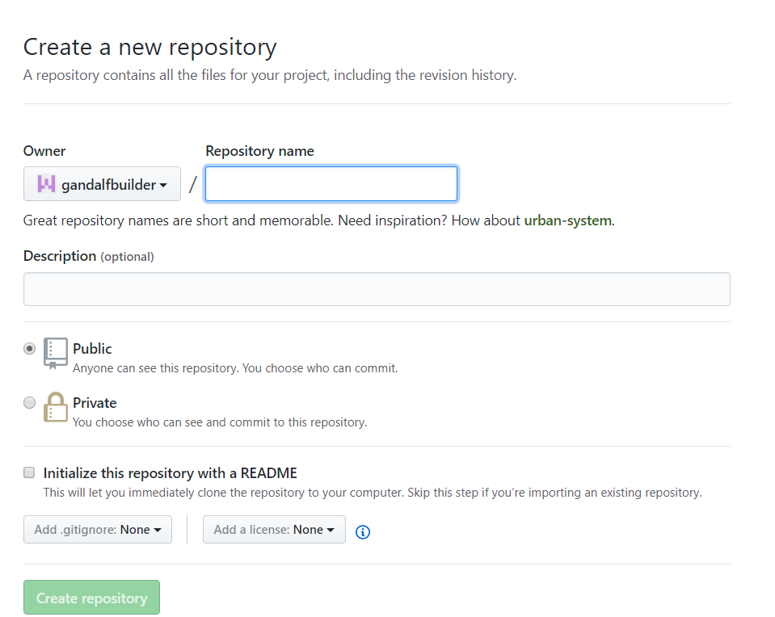
In GitHub, the folder in the cloud where you can store, update, and share all the files that make up your website is called a repository.
The next step you’ll take is to name your new repository. This is a very crucial step in the process

Slide 12
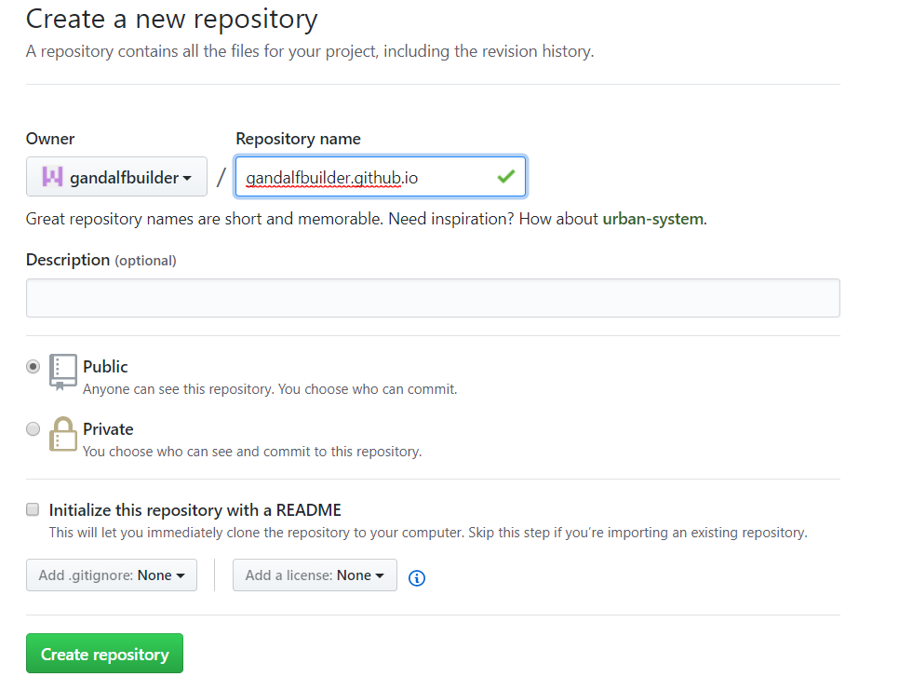
The first part of your repository name needs to be exactly the same as the username you created earlier or your page will not load properly later.
Then, you must follow that name with .github.io
So if our GitHub username is gandalfbuilder, then we would name our repository gandalfbuilder.github.io

Slide 13
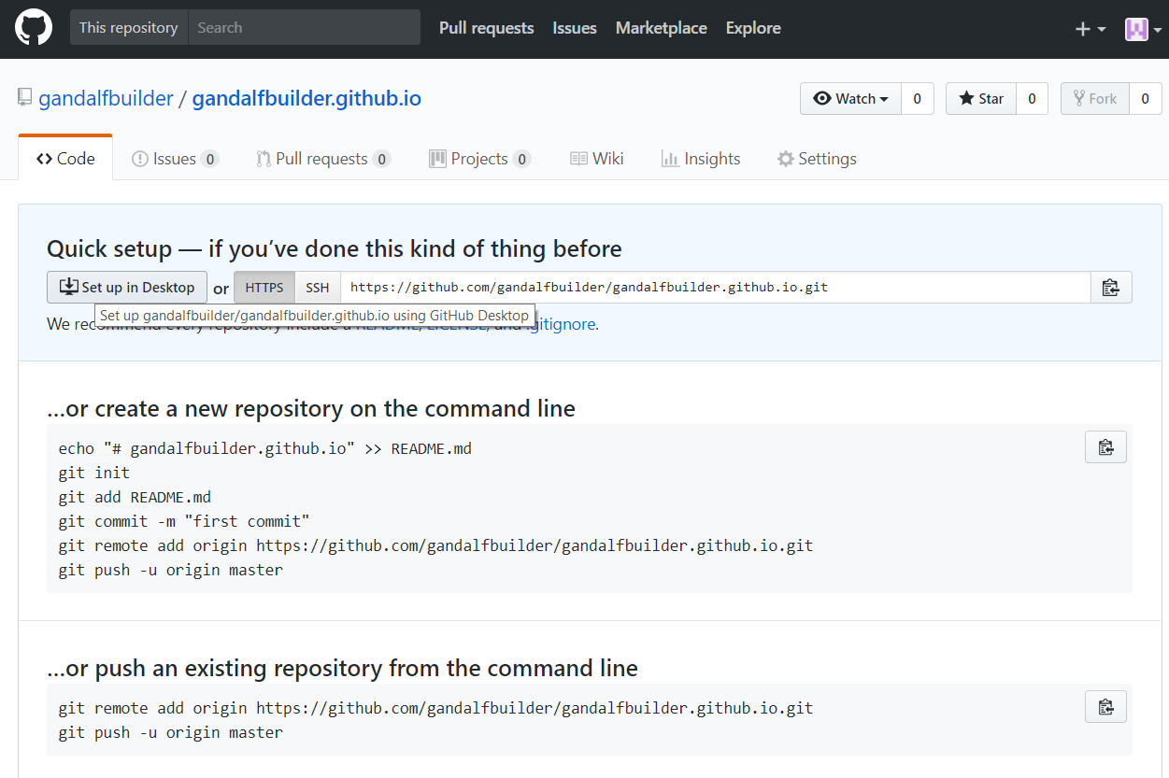
After naming your new repository, you don’t need to adjust any other settings, so just click Create Repository.
Click the set up in desktop button.
This will bring you back to the GitHub App you downloaded earlier.

Slide 14
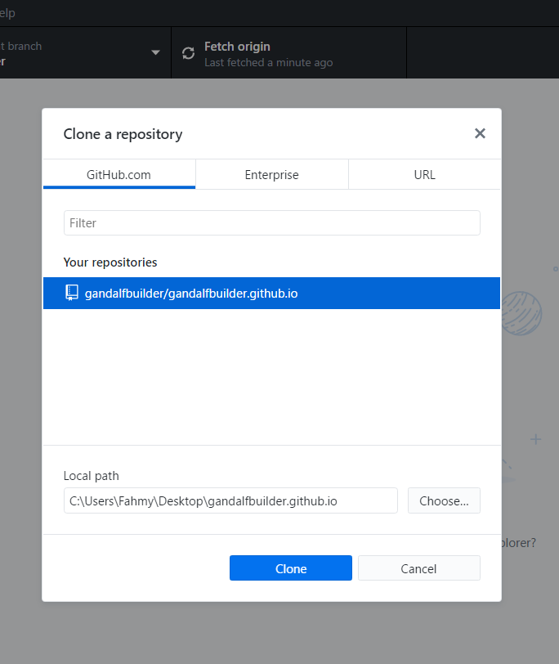
As GitHub App opens, select clone a repository. Select your repository and click clone.
Basically, cloning make a copy of your GitHub repository, which live online in the cloud and saves it as a local folder on your computer.
Doing this will allow you to create and edit files locally, then sync up those changes to your GitHub repository when you’re done.

Slide 15
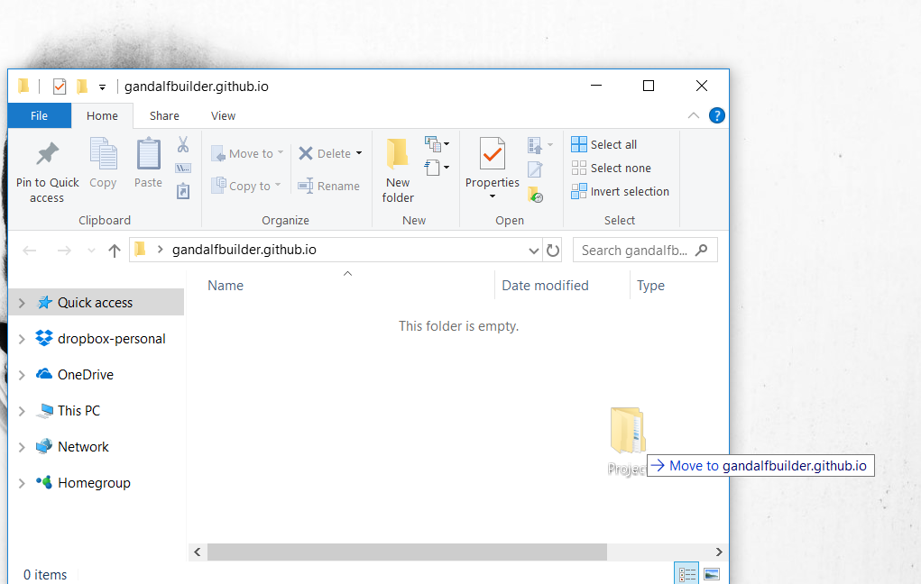
Take the folder you made earlier and put it inside your new cloned folder. It should look like this:

Slide 16
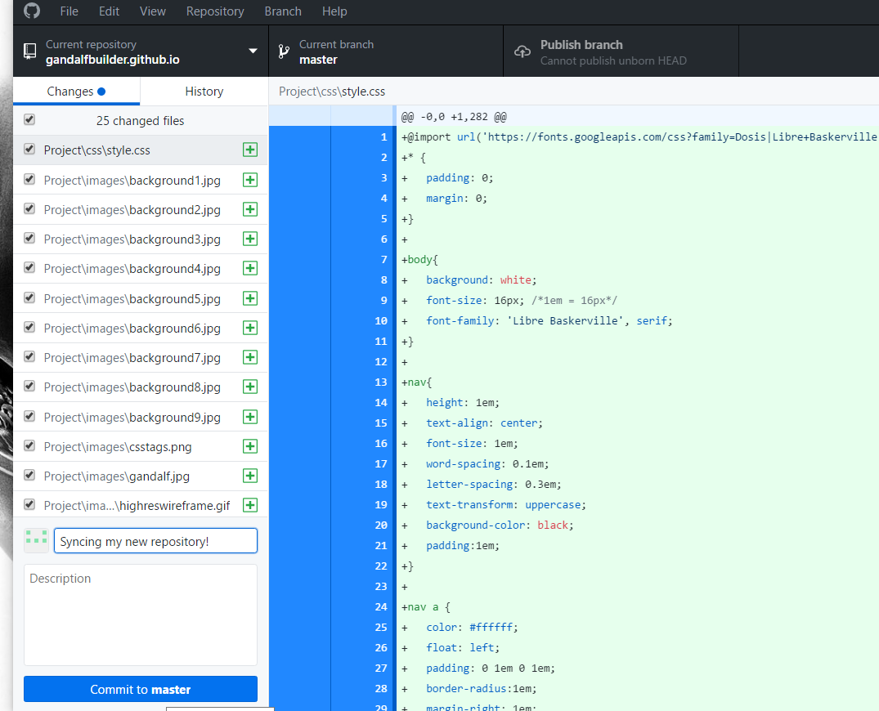
When you open the GitHub app, it will automatically recognize any changes you’ve made in your cloned folder.
To sync these changes with your repository, take the following steps:
First – make sure you’re in the section labelled Changes
Second – in the summary field, type a message describing the update, such as “syncing my new repository!”

Slide 17
Third – click commit to master
Fourth- click Publish to branch
Make sure to follow these steps every time you finish adding or editing content in your local cloned folder to make sure your online repository is always up to date.

Slide 18
To visit your new web page, open your browser and use the following pattern to enter your URL:
http://your _repository_name/the_folder_name/the_file_name
Unfortunately, the very first time you commit and sync a new repository, it can take anywhere between 0 and 30 mins for GitHub to prepare your files.
If you visit your page before it’s ready, you might get an error message.

